Slide 1
Reform and disruption: Survive and thrive
New England Regional CHSP Forum
Tamworth, 29 August 2017
Notes:
Introduction to Home Nursing group-
Home Nursing Group is a Commonwealth Approved Provider of community aged care services:
Home Care Packages (all four levels)
Commonwealth Home Support programme (CHSP)
Veterans’ Home Care
Private nursing services
Our services include domestic assistance, social support, home maintenance, personal care, skilled nursing respite, palliative care and 24/7 live-in care.
As a government approved aged care provider we have a current staff number of over 130 staff including Care givers, Endorsed Enrolled Nurses, Registered Nurses, administration and Care and Support Coordination staff. My role as Chief People and Culture Officer assists in strategic human resource management, industrial relations supports and includes training and service innovation.

Slide 2
Fifth Avenue NYC Easter Sunday 1900
Notes:
In order to create our organisational training strategy, Home Nursing Group considers the following:
We consider strategic measures- industry reflections such as the introduction of new referral systems and consumer directed care models.
We treat education as a form of internal messaging- this is the key- training can be used as a conversation with your staff.
We assess individual needs of staff- this is done both at recruitment and in an ongoing manner through line managers
We use a performance management system to flag individual needs as well as our incidence register to flag areas of concern
We endeavour to carry through a marriage of consistent training to the themes of business and culture. We ensure that themes of learning are carried through our internal communications, staff newsletters and policy dissemination at team meetings. We understand that education modules on the Aged Care Channel or face to face training is best delivered in context and in that was is able to meet baseline competencies while speaking to our core philosophy and cultural values.
A good example of this has been with the recent shift in consumer directed services in Home Care: Care givers needed to understand the new service plans and care directives being provided to clients under Consumer Directed Care and some of the more ‘flexible’ services delivered, whilst Care and Support Coordination staff were required to re-train in care management and care planning that delivered a re-enablement and consumer directed care focus. We simultaneously delivered modules through the Aged Care Channel on line, and face to face training pitched to staff at appropriate levels whilst rolling out the new CDC policy to all staff. To ensure these messages were reinforced we then delivered strategic messages from the executive speaking to our core philosophies around customer service and exceptional came alongside articles from the industry and additional learning links for staff.

Slide 3
Fifth Avenue NYC
Easter Sunday 1913
Notes:
The use of the Aged Care Channel allows Home Nursing Group to:
Create structured and tailor-made educational pathways for staff
Provide a standardised learning platform with access to additional education on a needs basis
Monitor and support staff in their learning across geographies and roles
Make learning a common and integral way of working at HNG- it is a part of our business language
Access live time education completion and adherence reports
Easily identify and flag underperformers and poor engagement
Receive feedback from staff on usefulness of the modules and adjust the program planning in a flexible and efficient manner

Slide 4
Rule 1: Don’t be a dead fish
Notes:
The use of the Aged Care Channel allows Home Nursing Group to:
Create structured and tailor-made educational pathways for staff
Provide a standardised learning platform with access to additional education on a needs basis
Monitor and support staff in their learning across geographies and roles
Make learning a common and integral way of working at HNG- it is a part of our business language
Access live time education completion and adherence reports
Easily identify and flag underperformers and poor engagement
Receive feedback from staff on usefulness of the modules and adjust the program planning in a flexible and efficient manner

Slide 5
Disruptive forces: then & now
THEN
Internal combustion engine
Telegraph
Electricification
Factory system
NOW
Automation of routine work
Data and artificial intelligence
Digital transformation
Robotics & autonomous vehicles
Notes:
The use of the Aged Care Channel allows Home Nursing Group to:
Create structured and tailor-made educational pathways for staff
Provide a standardised learning platform with access to additional education on a needs basis
Monitor and support staff in their learning across geographies and roles
Make learning a common and integral way of working at HNG- it is a part of our business language
Access live time education completion and adherence reports
Easily identify and flag underperformers and poor engagement
Receive feedback from staff on usefulness of the modules and adjust the program planning in a flexible and efficient manner

Slide 6
Rule 2: It’s not pie
Notes:
The use of the Aged Care Channel allows Home Nursing Group to:
Create structured and tailor-made educational pathways for staff
Provide a standardised learning platform with access to additional education on a needs basis
Monitor and support staff in their learning across geographies and roles
Make learning a common and integral way of working at HNG- it is a part of our business language
Access live time education completion and adherence reports
Easily identify and flag underperformers and poor engagement
Receive feedback from staff on usefulness of the modules and adjust the program planning in a flexible and efficient manner

Slide 7
Questions to ask
Who are our customers ?
What’s our business model ?
What’s our competitive advantage ?
Where’s our market ?
What’s our plan ?
Notes:
The use of the Aged Care Channel allows Home Nursing Group to:
Create structured and tailor-made educational pathways for staff
Provide a standardised learning platform with access to additional education on a needs basis
Monitor and support staff in their learning across geographies and roles
Make learning a common and integral way of working at HNG- it is a part of our business language
Access live time education completion and adherence reports
Easily identify and flag underperformers and poor engagement
Receive feedback from staff on usefulness of the modules and adjust the program planning in a flexible and efficient manner

Slide 8
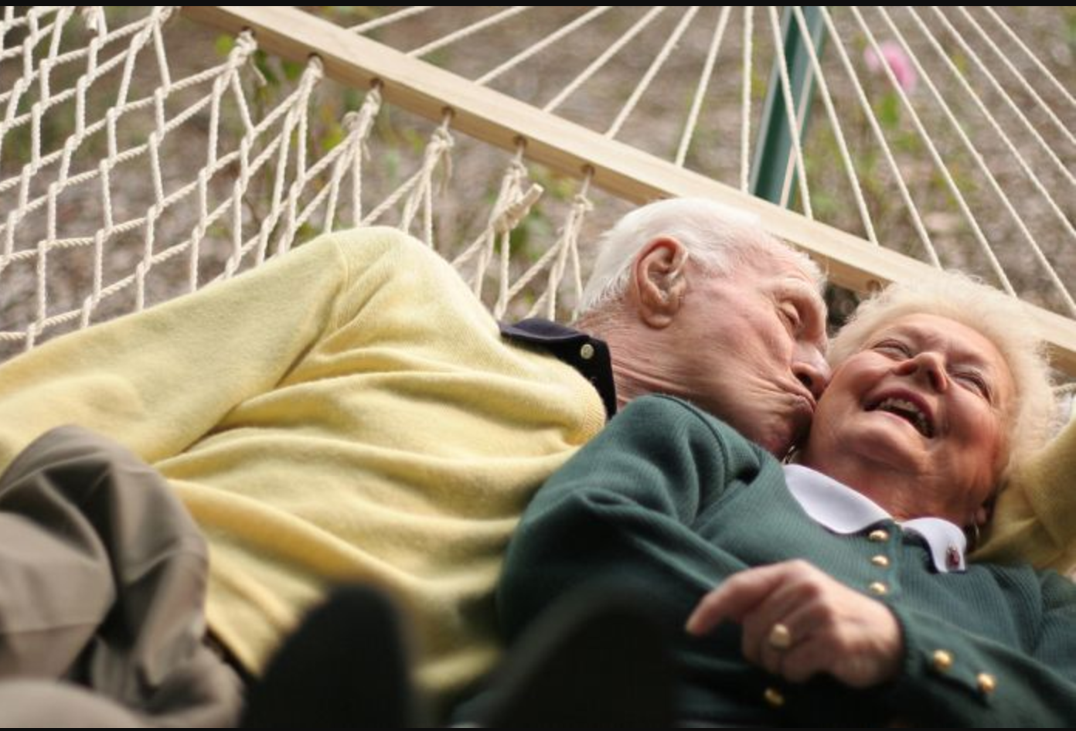
Rule 3: K.I.S.S.
Notes:
The use of the Aged Care Channel allows Home Nursing Group to:
Create structured and tailor-made educational pathways for staff
Provide a standardised learning platform with access to additional education on a needs basis
Monitor and support staff in their learning across geographies and roles
Make learning a common and integral way of working at HNG- it is a part of our business language
Access live time education completion and adherence reports
Easily identify and flag underperformers and poor engagement
Receive feedback from staff on usefulness of the modules and adjust the program planning in a flexible and efficient manner

Slide 9
Focus, discipline and simplicity
“That's been one of my mantras - focus and simplicity. Simple can be harder than complex. You have to work hard to get your thinking clean to make it simple.”
Steve Jobs
Notes:
The use of the Aged Care Channel allows Home Nursing Group to:
Create structured and tailor-made educational pathways for staff
Provide a standardised learning platform with access to additional education on a needs basis
Monitor and support staff in their learning across geographies and roles
Make learning a common and integral way of working at HNG- it is a part of our business language
Access live time education completion and adherence reports
Easily identify and flag underperformers and poor engagement
Receive feedback from staff on usefulness of the modules and adjust the program planning in a flexible and efficient manner

Slide 10
Rules to survive and thrive
Attitude – remember the fish
Opportunities – remember the pie
Discipline – keep on “KISS”-ing
homenursinggroup.com.au

